Slide 1
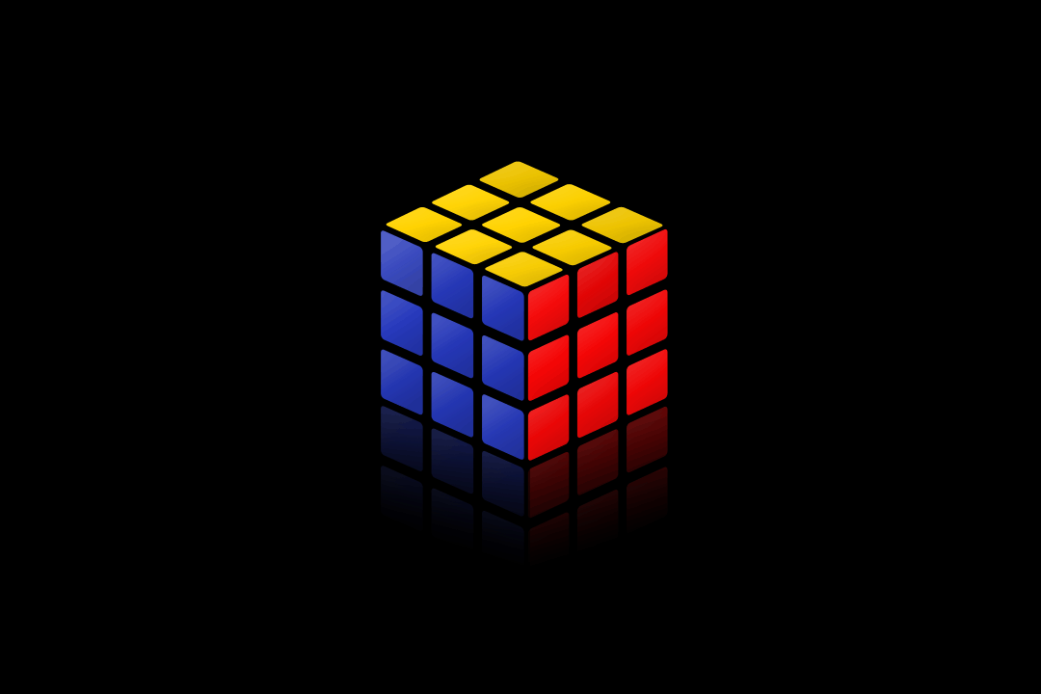
3x3x3 Rubik’s Cube Solver
Divyesh Jagetia

Slide 2
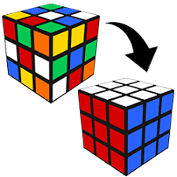
Content
Rubik’s cube overview
Previous methods to solve
High Level Project work flow-
Computer Vision
Representing Cube in data structures
Optimization Method
Demo
Future work and conclusion
Notes:
Checking if it shows up

Slide 3

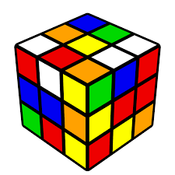
Rubik’s Cube Introduction
43 Quintillion Possible Permutations
Constraints -
Invalid Orientations, Move Constraints
Prominent Solutions-
Fredrich’s Method - Cross -> First two layers -> Orientation -> Permutations.
Brute Force Search - A*
Iterative Deepening A*
Adversarial Search- 2-Phase Iterative Deepening A*
2-Phase A* + Binary Satisfiability Problem (SAT)
Reverse tracking/ Backward search (Bottom - Up) - Neural Network will have a tough time knowing how to update the states since randomly doing moves will not likely stumble upon the solved cube state
Notes:
notations, constraints, permutations and orientations

Slide 4
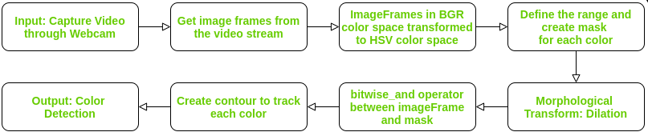
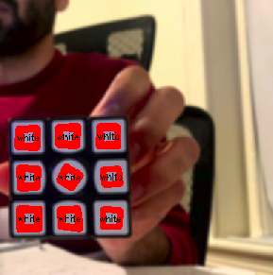

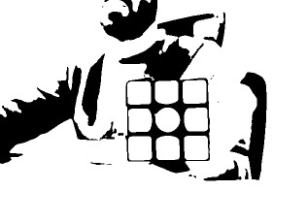

Project Part1 Computer Vision
Notes:
Put images at each step

Slide 5
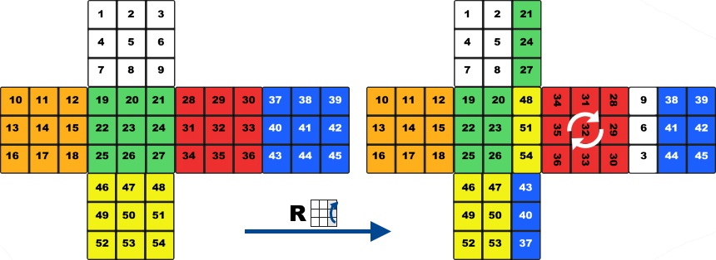
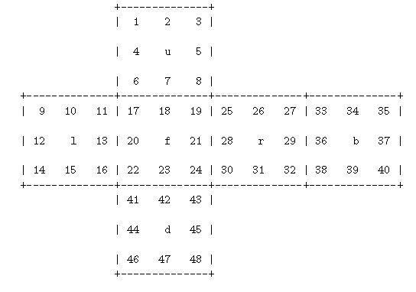
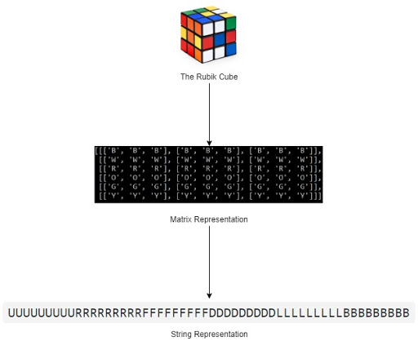
Representing cube in code
Constraints:
Storing all the moves in a table saves time complexity

Slide 6
Combinatorial Optimization Problem / Group Theory
Goal: Looks for the optimal solution without explicitly generating all potential solutions
Iterative Deepening A* Search with lower bound heuristic function (Depth Bound) eg TSP, 8 queen (a-b pruning NDS actions)
Kociemba Algo groups the cube into state "G1":<U,D,R2,L2,F2,B2>
All the corners are oriented
All the edges are oriented
All the middle layer edges are already in the middle layer.
This algo divides into two phases, before and after G1.
Notes:
Eg. Travelling Salesman Problem, 8 Queen (max CSP)

Slide 7
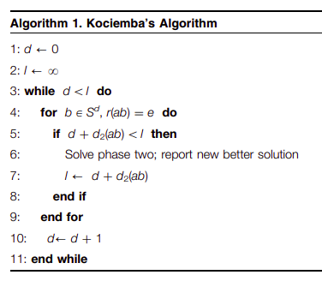
Two Phase- Iterative Deepening A* search Algorithm
Kociemba’s algorithm splits the problem into two roughly equal subproblems
Check validity by comparing edge and cubie orientations
Phase 1- Finds path to an orientation that is a subset of G1 = <U,D,R2,L2,F2,B2> (check and make it Symmetry)
Phase 2 - IDA* Search with heuristic h2(a,b,c)
Result send - using reverse BFS way

Slide 8
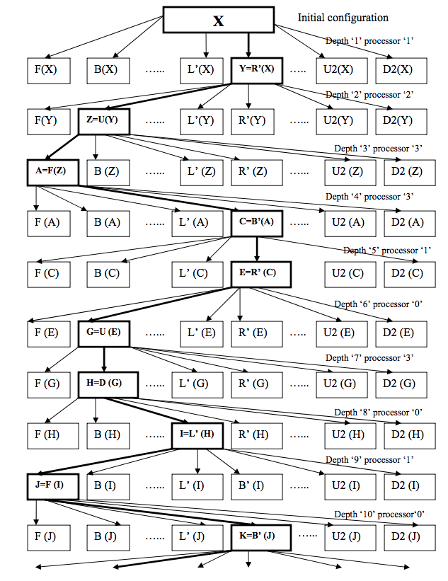
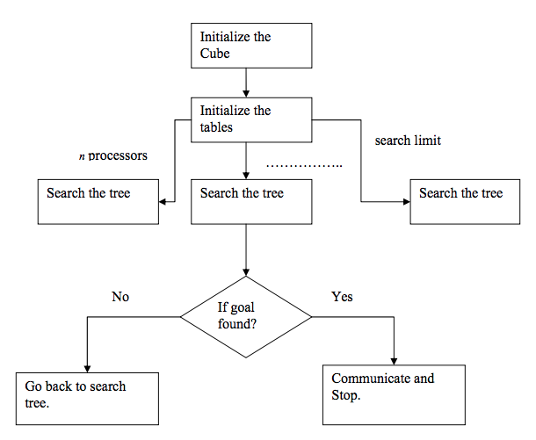
Two Phases - Iterative Deepening A* Search
Depth <11

Slide 9
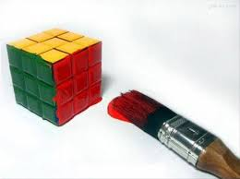
Future Work:
Generalise algo for NxNxN cube
Reinforcement Learning - Deep QN
Conclusion:
Developing solutions to hard combinatorial puzzles like Rubik’s cube can help us moving forward with difficult engineering challenges or problems that are too hard to solve using an exhaustive brute force approach.
Reference:
www.kociemba.org

Slide 10
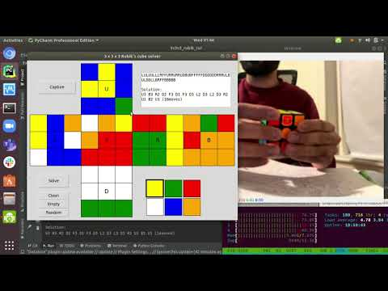
Demo

Slide 11
Thank You
https://github.com/supercode-r/RubiksCubeSolver

